Slide 1
Troubleshooting your system
Recovering the super user passwords
Recovering the boot loader (GRUB)
Troubleshooting network related problems

Slide 2
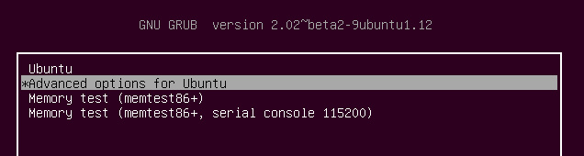
Recovering the super user Password
Step 1:- When you start your system, press "ESC" key continuously to get the grub loader screen. Select 2nd option .You will then be prompted by a menu that looks something like this.

Slide 3
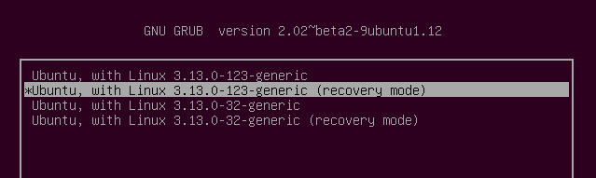
Step 2:- Select recovery mode.

Slide 4
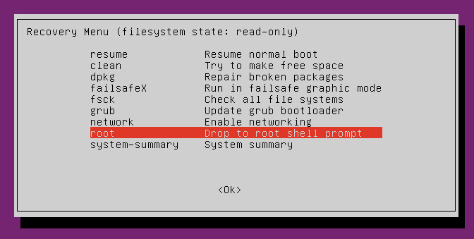
Using the arrow keys scroll down to “ root “ and then hit Enter. You should now see a root prompt, something like this: - root@ubuntu:~#
After that you can change the password using passwd Command

Slide 5
Repairing the boot loader (GRUB)
Grub (GRand Unified Bootloader) is the default boot loader application for most Linux/Unix systems. It lets users choose from multiple operating systems (provided you have more than one operating systems installed on your system) or boot into different kernel versions if your computer system is running only Linux operating system.

Slide 6
Boot Repair is the most commonly used tool to fix errors regarding Grub boot loader. First of all arrange a Live CD/DVD/ USB for Ubuntu and boot your system using this media (If you are looking to repair Grub, chances are you are already on the stage where system is un-bootable into current operating system, so yes its a valid request to use Live CD/DVD/USB at this point ).

Slide 7
Once you are logged into your system using Live disk, run following command to add “Boot Repair” tool’s PPA to your system.
# sudo add-apt-repository ppa:yannubuntu/boot-repair
# sudo apt-get update
Run following command to install Boot Repair tool now.
# sudo apt-get install -y boot-repair

Slide 8
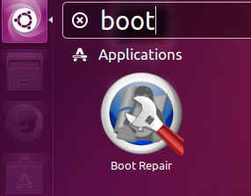
That’s it, Boot Repair has been installed successfully now. Launch it from Applications > Boot Repair option.

Slide 9
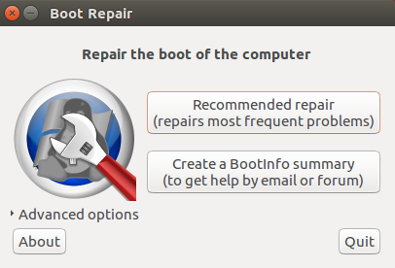
One Boot Repair tool is launched from Unity > Applications > Boot Repair option, here is the welcome screen you should see.

Slide 10
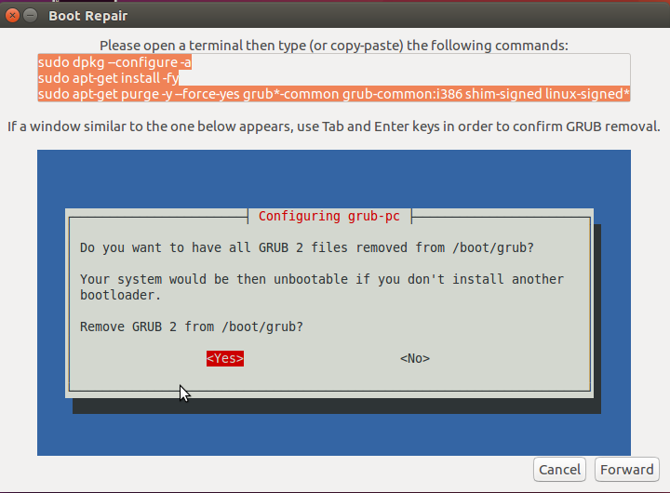
The very first option (Recommended repair) should fix the Grub loader for you, hit it and it should initiate the repair/re-install process for you. Here is the first screen it will display.

Slide 11
As instructed in the above screenshot, launch your system’s terminal and run following three commands in order.
# sudo dpkg --configure -a
# sudo apt-get install -fy
# sudo apt-get install -y --force-yes grub-pc linux-generic

Slide 12
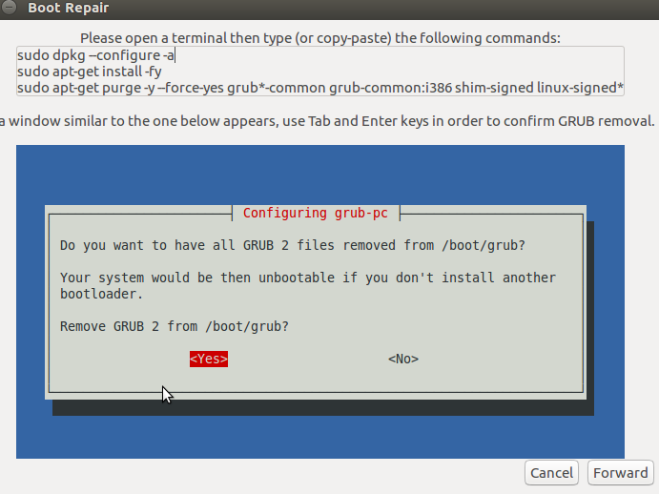
Once above mentioned command’s execution complete, click “Forward” to take the repair process to the next step. Here is what you will be seeing on next step.

Slide 13
As instructed, run following three commands on the terminal in proper order. During this step, it will load a pop up to confirm Grub 2 removal, choose “Yes” from the pop up you see here.
# sudo dpkg --configure -a
# sudo apt-get install -fy
# sudo apt-get install -y --force-yes grub-pc linux-generic
Click “Forward” once this process completes, here is the screenshot of the next step
.

Slide 14
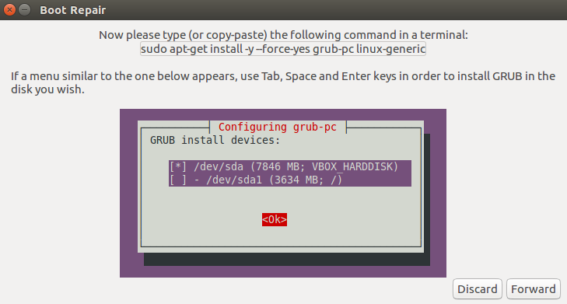

Slide 15
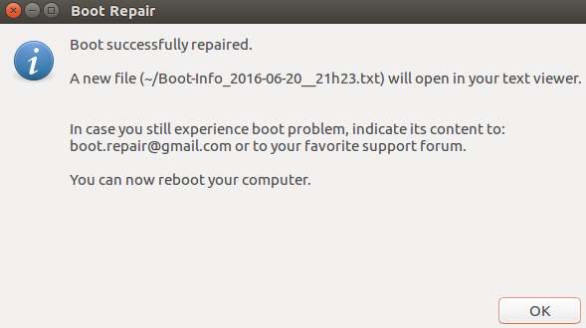
As instructed, run following command on the terminal and choose hard disk to install grub on when prompted.
# sudo apt-get install -y --force-yes grub-pc linux-generic
That’s it, it will take couple of minutes to perform the required operations and you should see the following success message upon completion ; congratulations! Grub has been repaired now.
Reboot your system and it should boot fine and boot loader related errors should be gone now.

